Slide 1
Satellite Communications
Chapter 9

Slide 2
Satellite-Related Terms
Earth Stations – antenna systems on or near earth
Uplink – transmission from an earth station to a satellite
Downlink – transmission from a satellite to an earth station
Transponder – electronics in the satellite that convert uplink signals to downlink signals

Slide 3
Ways to Categorize
Communications Satellites
Coverage area
  Global, regional, national
Service type
  Fixed service satellite (FSS)
  Broadcast service satellite (BSS)
  Mobile service satellite (MSS)
General usage
  Commercial, military, amateur, experimental

Slide 4
Classification of Satellite Orbits
Circular or elliptical orbit
  Circular with center at earth’s center
  Elliptical with one foci at earth’s center
Orbit around earth in different planes
  Equatorial orbit above earth’s equator
  Polar orbit passes over both poles
  Other orbits referred to as inclined orbits
Altitude of satellites
  Geostationary orbit (GEO)
  Medium earth orbit (MEO)
  Low earth orbit (LEO)

Slide 5
Geometry Terms
Elevation angle - the angle from the horizontal to the point on the center of the main beam of the antenna when the antenna is pointed directly at the satellite
Minimum elevation angle
Coverage angle - the measure of the portion of the earth's surface visible to the satellite

Slide 6
Minimum Elevation Angle
Reasons affecting minimum elevation angle of earth station’s antenna (>0º)
  Buildings, trees, and other terrestrial objects block the line of sight
  Atmospheric attenuation is greater at low elevation angles
  Electrical noise generated by the earth's heat near its surface adversely affects reception

Slide 7
GEO Orbit
Advantages of the the GEO orbit
  No problem with frequency changes
  Tracking of the satellite is simplified
  High coverage area
Disadvantages of the GEO orbit
  Weak signal after traveling over 35,000 km
  Polar regions are poorly served
  Signal sending delay is substantial

Slide 8
LEO Satellite Characteristics
Circular/slightly elliptical orbit under 2000 km
Orbit period ranges from 1.5 to 2 hours
Diameter of coverage is about 8000 km
Round-trip signal propagation delay less than 20 ms
Maximum satellite visible time up to 20 min
System must cope with large Doppler shifts
Atmospheric drag results in orbital deterioration

Slide 9
LEO Categories
Little LEOs
  Frequencies below 1 GHz
  5MHz of bandwidth
  Data rates up to 10 kbps
  Aimed at paging, tracking, and low-rate messaging
Big LEOs
  Frequencies above 1 GHz
  Support data rates up to a few megabits per sec
  Offer same services as little LEOs in addition to voice and positioning services

Slide 10
MEO Satellite Characteristics
Circular orbit at an altitude in the range of 5000 to 12,000 km
Orbit period of 6 hours
Diameter of coverage is 10,000 to 15,000 km
Round trip signal propagation delay less than 50 ms
Maximum satellite visible time is a few hours

Slide 11
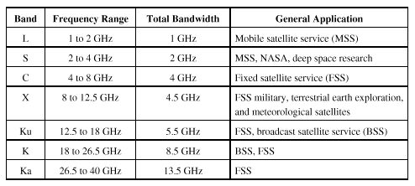
Frequency Bands Available for Satellite Communications

Slide 12
Satellite Link Performance Factors
Distance between earth station antenna and satellite antenna
For downlink, terrestrial distance between earth station antenna and “aim point” of satellite
  Displayed as a satellite footprint (Figure 9.6)
Atmospheric attenuation
  Affected by oxygen, water, angle of elevation, and higher frequencies

Slide 13
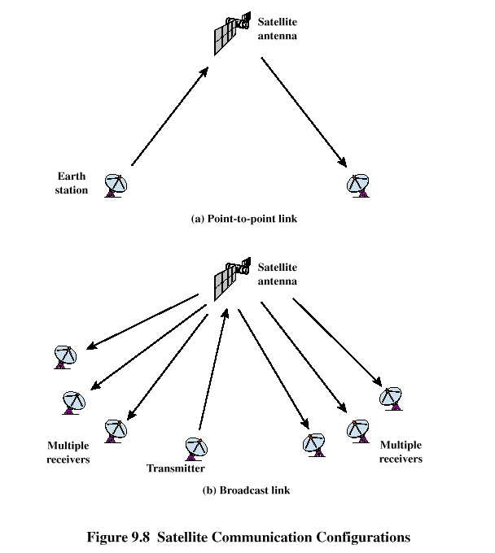
Satellite Network Configurations

Slide 14
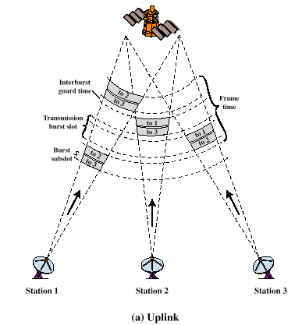
FAMA-TDMA Uplink

Slide 15
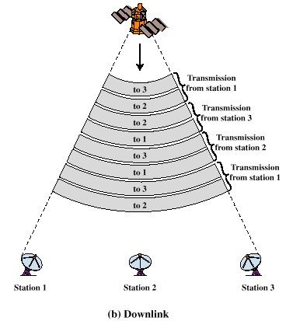
FAMA-TDMA Downlink

